Slide 1

REAL ESTATE
HITESH 18csu086
HRITHIK 18CSU088

Slide 2

HEADING
Introduction
Problem teardown
Getting started
Model
Performance measure
Assumption
About dataset
Let’s code

Slide 3

INTRODUCTION
We have taken a dataset of a real estate company
We will see how the company process and progress will going to take place in our upcoming slide
We have taken our dataset from UCI boston repository
So let’s start

Slide 4

PROBLEM TEARDOWN
We are given dataset of house price with some features like no of room .
Our task is to create a model which will predict the price for new house by looking the features.
While learning about machine learning it is best to actually work with real world data, not just artificial dataset.

Slide 5

GETTING STARTED
The first question Harish should ask Mr. Thomas is what is the business objective and end goal ? How will real estate benefit from the model?
Mr. Thomas tells Harish that real estate will use this model to predict house price in a given area and will invest in the area if its undervalued
Next question Harish should ask Mr Thomas is how does the current solution look like ? The answer is – Manual experts who analyse the features
The prediction made by so called “experts” are not very good (error rate is 25%) which is why real estate Pvt. Ltd is counting on Harish

Slide 6
FINDING THE MODEL
Supervised , unsupervised or reinforcement Learning ?
Classification task or regression task ?
Batch learning or online learning technique ?

Slide 7

PERFORMANCE MEASURE
A typical performance mesure for regression problem is the root Mean Square Error (RMSE).
RMSE is generally the preferred performance measure for regression tasks , so we chose it for this particular problem we are solving for real estste.
Other performance measure include Mean Absolute Error , Manhattan norm, etc but we will use RMSE for the problem.

Slide 8

ASSUMPTIONS
It is very important for Harish to check for any assumptions he might have made and correct them before launching the ml system.
for example ,he should make sure that the team needs the price and not the categories like expensive, cheap etc.
If latter is the case formulating the problem as a regression task will be counted as a big mistake
Harish talked to the real estate team members and ensured that he is aware of all the assumption.

Slide 9
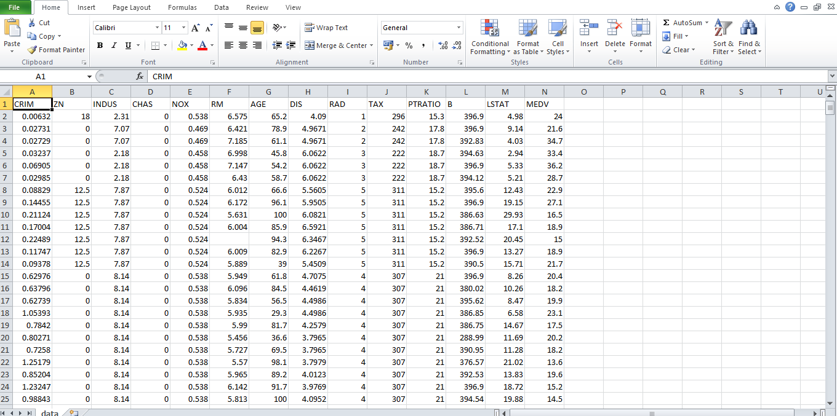
DATASET

Slide 10
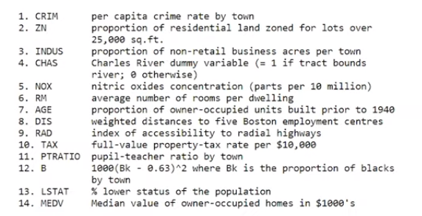

Slide 11

ALL SET FOR CODE
The light is green and harish is all set for coding .
Harish will use jupyter notebook.
The jupyter notebook is an open source web application that allow you to create and share documents that contain live code , equation, visualisation and narrative text.
This will make it easy for Harish for document and use code as a notebook.

Slide 12


Slide 13


Slide 14


